Slide 1
Android Development

Slide 2
Goals
Understand Activity basics
Understand View/XML basics
Create a functional app

Slide 3
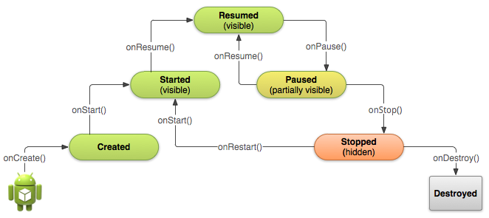
Activities
Instead of main(), an Activity class is the entry point of your application
A beginner way to think of Activities is that each Activity is its own screen.
A series of calls are made to tell you what state your application is in.

Slide 4
XML
Views
A view is an element on screen.
Examples: button, label (textview), textfield, textarea, spinner, listview
To start, we’ll be looking at buttons, labels, and textfields.
XML is used to layout the graphical elements on screen
A graphical editor does exist for Android, but what you see on screen is not always what appears on the actual phone
Editing the XML by hand is kind of a pain in the ass, but it’s a necessary evil, and one that gets easier with experience.

Slide 5
Intents
Intents are most commonly used to transfer data between activities.
They’re called intents because they’re “an abstract description of an operation to be performed”
Some other applications of intents:
Starting background services (e.g. collect weather information every 30 minutes)
Setting alarms using the system alarm clock
Uses “actions” to perform certain operations. For example, when your applications start, an intent with a “MAIN” action is performed, which your application receives.
One of my favorite lines in Android’s documentation:
“ACTION_RUN
Activity Action: Run the data, whatever that means.
Input: ?
Output: Nothing.”

Slide 6
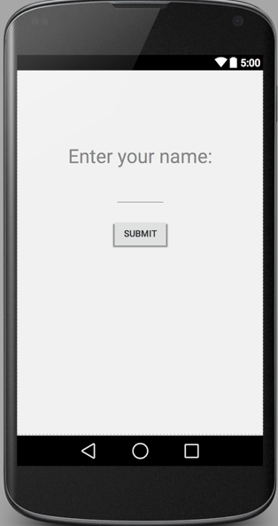
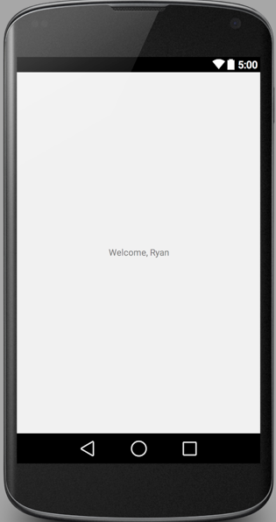
The App
User is prompted to enter their name into a textfield, then click a button
New screen (Activity!) comes up greeting them to the app.

